Slide 1
Jesus, Our Shepherd King
“But you, Bethlehem Ephrathah, though you are small among the clans of Judah, out of you will come for me one who will be ruler over Israel, whose origins are from of old, from ancient times.” —Micah 5:2

Slide 2
1) Trust God’s Shepherd King
Vs. 1–6

Slide 3
1) Trust God’s Shepherd King
Micah 5:1 Marshal your troops now, city of troops, for a siege is laid against us. They will strike Israel's ruler on the cheek with a rod.
Micah 3:11 Her leaders judge for a bribe, her priests teach for a price, and her prophets tell fortunes for money. Yet they look for the LORD's support and say, "Is not the LORD among us? No disaster will come upon us."

Slide 4
1) Trust God’s Shepherd King
Micah 5:3 Therefore Israel will be abandoned until the time when she who is in labor bears a son, and the rest of his brothers return to join the Israelites.

Slide 5
1) Trust God’s Shepherd King
Micah 5:2 "But you, Bethlehem Ephrathah, though you are small among the clans of Judah, out of you will come for me one who will be ruler over Israel, whose origins are from of old, from ancient times."

Slide 6
1) Trust God’s Shepherd King
Micah 5:2 "But you, Bethlehem Ephrathah, though you are small among the clans of Judah, out of you will come for me one who will be ruler over Israel, whose origins are from of old [mikedem], from ancient times [mimey olam]."

Slide 7
1) Trust God’s Shepherd King
Micah 7:14 Shepherd your people with your staff, the flock of your inheritance, which lives by itself in a forest, in fertile pasturelands. Let them feed in Bashan and Gilead as in days long ago [cimey olam].
Micah 7:20 You will be faithful to Jacob, and show love to Abraham, as you pledged on oath to our ancestors in days long ago [mimey kedem].

Slide 8
1) Trust God’s Shepherd King
Habakkuk 1:12 LORD, are you not from everlasting [kedem]? My God, my Holy One, you will never die. You, LORD, have appointed them to execute judgment; you, my Rock, have ordained them to punish.
Deuteronomy 33:27 The eternal [kedem] God is your refuge, and underneath are the everlasting [olam] arms. He will drive out your enemies before you, saying, 'Destroy them!'

Slide 9
1) Trust God’s Shepherd King
John 1:2 He was with God in the beginning.
John 17:5 And now, Father, glorify me in your presence with the glory I had with you before the world began.
Revelation 1:17 When I saw him, I fell at his feet as though dead. Then he placed his right hand on me and said: "Do not be afraid. I am the First and the Last.

Slide 10
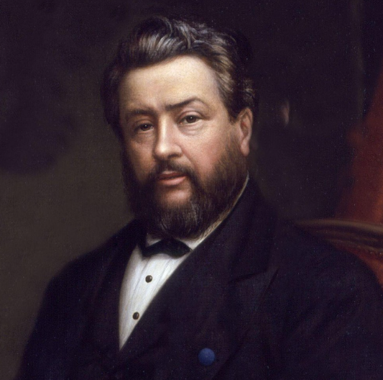
1) Trust God’s Shepherd King
"Infinite, and an infant. Eternal, and yet born of a woman. Almighty, and yet hanging on a woman's breast. Supporting a universe, and yet needing to be carried in a mother's arms. King of angels, and yet the reputed son of Joseph. Heir of all things, and yet the carpenter's despised son.“
—Charles Spurgeon

Slide 11
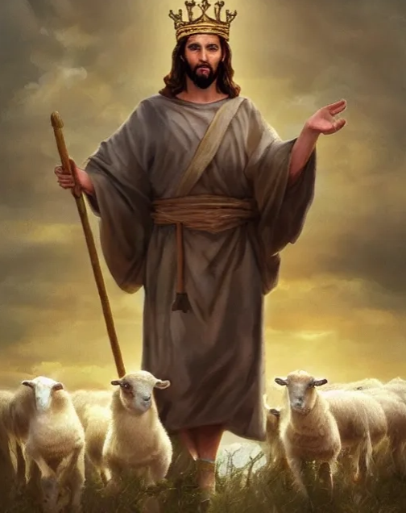
1) Trust God’s Shepherd King
Micah 5:4 He will stand and shepherd his flock in the strength of the LORD, in the majesty of the name of the LORD his God. And they will live securely, for then his greatness will reach to the ends of the earth.

Slide 12
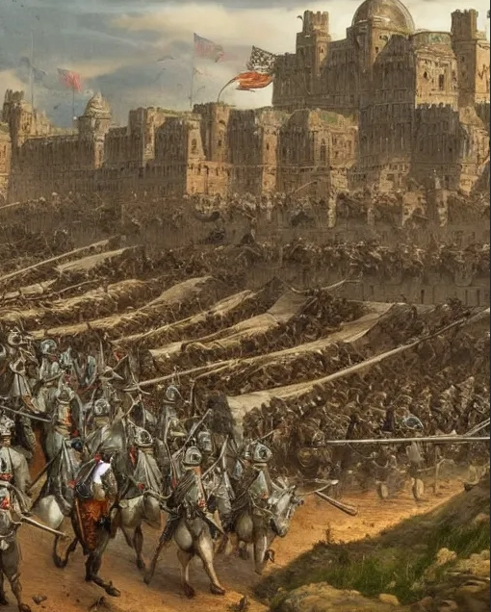
1) Trust God’s Shepherd King
Micah 5:5a And he will be our peace when the Assyrians invade our land and march through our fortresses. …

Slide 13
1) Trust God’s Shepherd King
Psalm 23:4-5a Even though I walk through the darkest valley, I will fear no evil, for you are with me; your rod and your staff, they comfort me. 5 You prepare a table before me in the presence of my enemies. …

Slide 14
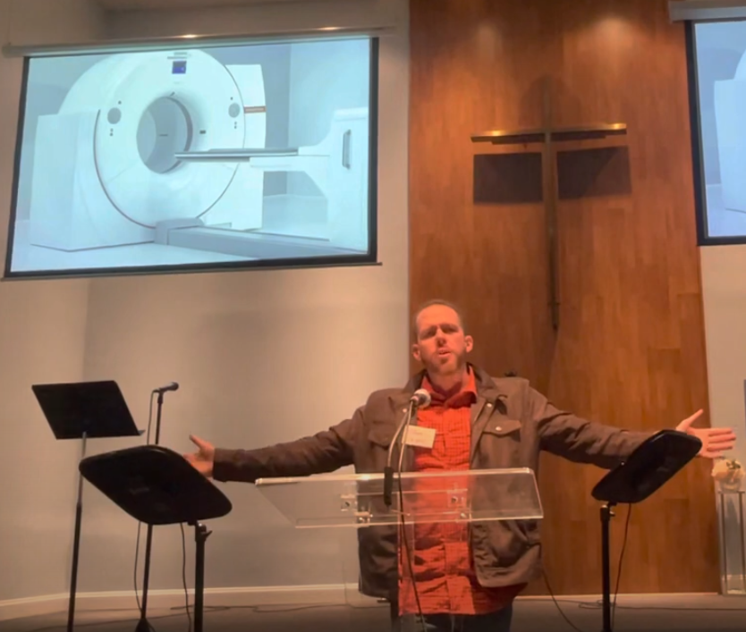
1) Trust God’s Shepherd King
“By God's grace though this event… it turned out to be a great blessing for my family. In this time I experienced that although I was dying, I was actually living. What I mean by that is that being so close to death I really experienced that faith in Jesus delivers. I experienced that there was no fear when I was almost about to die; instead, I had great peace that this was not the end, I wasn't gonna actually die, even though everyone around me—paramedics—is like, “This guy's gonna die.” But I'm here in my heart, “I'm not gonna die,” and there was no fear of death. And I've never been that close to death, but I can testify that this faith delivers in the time of trouble.”

Slide 15
1) Trust God’s Shepherd King
John 16:33 "I have told you these things, so that in me you may have peace. In this world you will have trouble. But take heart! I have overcome the world."
John 10:11 "I am the good shepherd. The good shepherd lays down his life for the sheep.

Slide 16
1) Trust God’s Shepherd King
Micah 5:5b-6 … We will raise against them seven shepherds, even eight commanders, 6 who will rule the land of Assyria with the sword, the land of Nimrod with drawn sword. He will deliver us from the Assyrians when they invade our land and march across our borders.
Ephesians 6:12 For our struggle is not against flesh and blood, but against … the spiritual forces of evil in the heavenly realms.
Ephesians 6:17 Take the helmet of salvation and the sword of the Spirit, which is the word of God.

Slide 17
2) Follow God’s Shepherd King to Bless and Triumph
Vs. 7–9

Slide 18
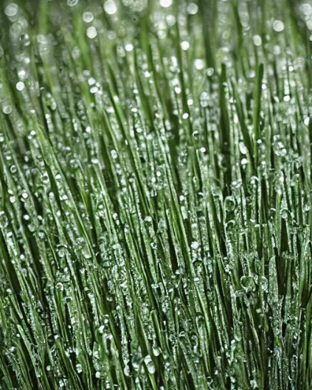
2) Follow God’s Shepherd King to Bless and Triumph
Micah 5:7 The remnant of Jacob will be in the midst of many peoples like dew from the LORD, like showers on the grass, which do not wait for anyone or depend on man.
Matthew 5:16 In the same way, let your light shine before others, that they may see your good deeds and glorify your Father in heaven.

Slide 19
2) Follow God’s Shepherd King to Bless and Triumph
Micah 5:8-9 The remnant of Jacob will be among the nations, in the midst of many peoples, like a lion among the beasts of the forest, like a young lion among flocks of sheep, which mauls and mangles as it goes, and no one can rescue. 9 Your hand will be lifted up in triumph over your enemies, and all your foes will be destroyed.

Slide 20
2) Follow God’s Shepherd King to Bless and Triumph
2 Corinthians 5:9 So we make it our goal to please him, whether we are at home in the body or away from it.
Revelation 12:11 They triumphed over him by the blood of the Lamb and by the word of their testimony; they did not love their lives so much as to shrink from death.

Slide 21
3) Repent of Idols
Vs. 10–15

Slide 22
3) Repent of Idols
Micah 5:10-14 "In that day," declares the LORD, "I will destroy your horses from among you and demolish your chariots. 11 I will destroy the cities of your land and tear down all your strongholds. 12 I will destroy your witchcraft and you will no longer cast spells. 13 I will destroy your idols and your sacred stones from among you; you will no longer bow down to the work of your hands. 14 I will uproot from among you your Asherah poles when I demolish your cities."

Slide 23
3) Repent of Idols
“If only God would give me ____, then I would be happy.”
“If I lost ____, then my life wouldn’t be worth living.”

Slide 24
3) Repent of Idols
Romans 2:6-8 God "will repay each person according to what they have done." 7 To those who by persistence in doing good seek glory, honor and immortality, he will give eternal life. 8 But for those who are self-seeking and who reject the truth and follow evil, there will be wrath and anger.

Slide 25
Jesus, Our Shepherd King
Micah 5:2 "But you, Bethlehem Ephrathah, though you are small among the clans of Judah, out of you will come for me one who will be ruler over Israel, whose origins are from of old, from ancient times."

